Slide 1
welcome

Slide 2
GROUP MEMBERS
YASH SINGHAL VINAYAK SINGH RATHOUR VIKAS JAISWAL SHUAIB AHAMAD

Slide 3



Presentation On E-commerce
Website(V A V Y)

Slide 4
What is E-commerce?
Commonly known as Electronic marketing.
It consist of buying and selling goods and
services over an Electronic systems such as internet
and other computer networks.

Slide 5
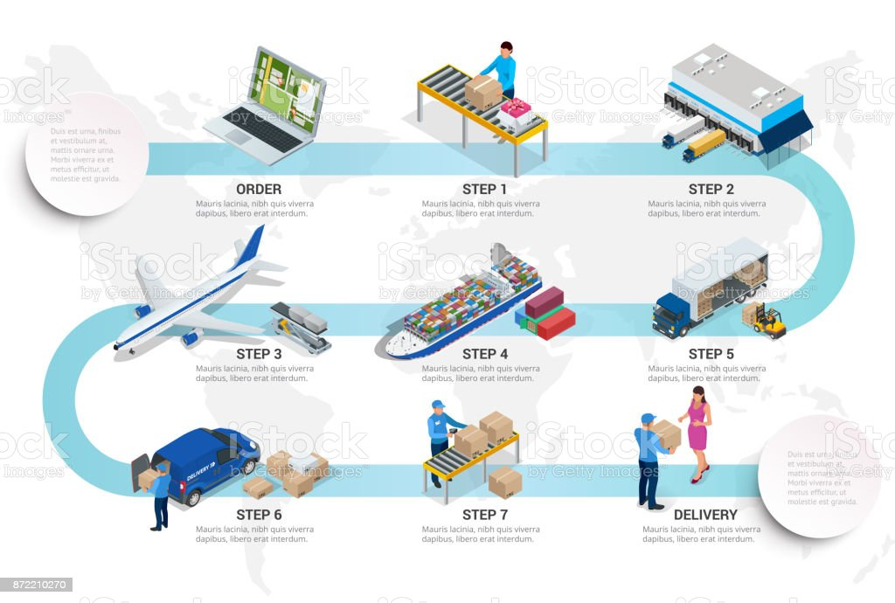
Process Of E-Commerce

Slide 6
Languages
Tools
HTML
CSS
java script
Adobe Photoshop
Visual Studio Code

Slide 7
Advantages of E-commerce
Buying selling 24/7
More reach to customers
Low operational costs
No need of physical company set-ups

Slide 8
Problem Statement
E-commerce provides an easy way to sell products to a large customer base.
The purpose of any e-commerce website is to help customers narrow down their broad ideas and enable them to finalize the products.

Slide 9
FUTURE PLAN
We are thinking about the
Modification and adding some more
advanced features.
GUI modification
Users can easily signup/login with more
Security features

Slide 10
GUI(Graphical User Interface)

Slide 11
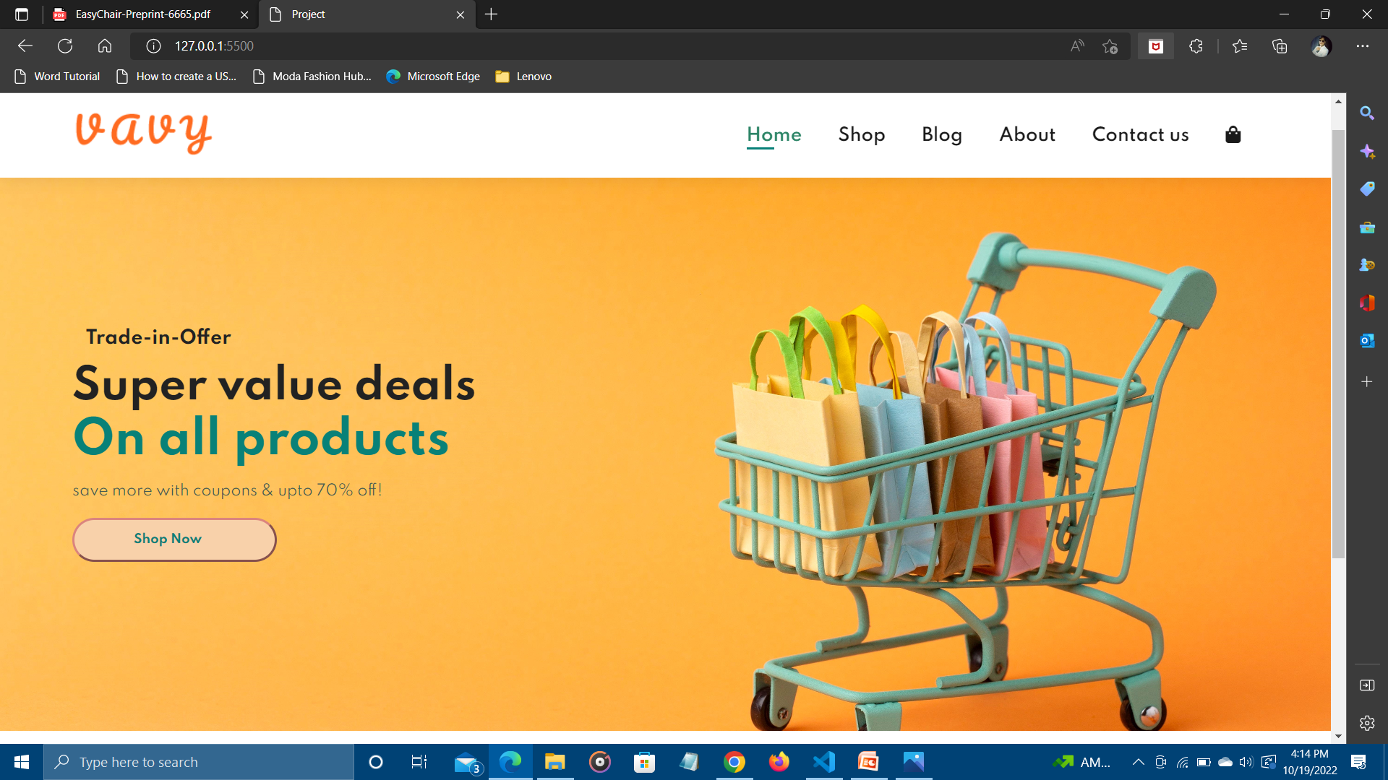
HOMEPAGE

Slide 12
THANK YOU !

